Slide 1
Using AI to Predict Lung Cancer Early by
Combining Clinical Records and Medical Imaging
Submitted in the partial fulfillment for the award of the degree of
BACHELOR OF ENGINEERING
IN
B.E CSE ( AIML )
Submitted by:
Jashandeep Singh (24BAI70540)
Anshul (24BAI70425)
Pushpit Kumar Gaur (24BAI70534)
Kush (24BAI70604)
Under the Supervision of:
Prof. Poonam Jyoti
Department of AIT-CSE
DISCOVER . LEARN . EMPOWER

Slide 2
Outline
Introduction to Project
Problem Formulation
Objectives of the work
Methodology used
Results and Outputs
Conclusion
Future Scope
References

Slide 3
Introduction to Project
Lung cancer is the leading cause of cancer-related mortality worldwide due to late-stage diagnosis.
Traditional diagnosis relies heavily on manual CT scan interpretation, which can lead to human error.
Our Approach: A hybrid system that doesn't just look at images but also integrates patient clinical history (age, smoking habits, etc.) for a holistic diagnosis.

Slide 4
Problem Formulation
The Challenge: Early-stage tumors are often indistinguishable from harmless growths in standard CT scans.
The Gap: Most AI models focus only on image pixels and ignore clinical metadata that doctors use daily.
The Need: A multi-modal system that reduces "False Negatives" and speeds up the screening process.

Slide 5
Objectives of the Work
To develop a CNN-based architecture (VGG16) for high-accuracy lung cancer classification.
To integrate clinical records with imaging data to improve diagnostic reliability.
To achieve a classification accuracy exceeding 98% across four classes: Adenocarcinoma, Large Cell, Squamous Cell, and Normal.

Slide 6
Methodology used
Step 1: Data Collection: Hybrid dataset of CT Scan images (Kaggle) and simulated clinical records.
Step 2: Preprocessing: Image resizing (224x224), normalization, and data augmentation to prevent overfitting.
Step 3: Feature Extraction: Using VGG16 Transfer Learning to extract deep spatial features from lungs.

Slide 7
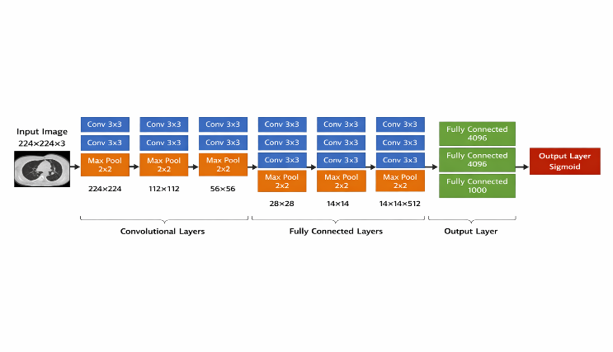
Methodology used
Step 4: Classification: A dense layer with Softmax activation to categorize the input into 4 classes.

Slide 8
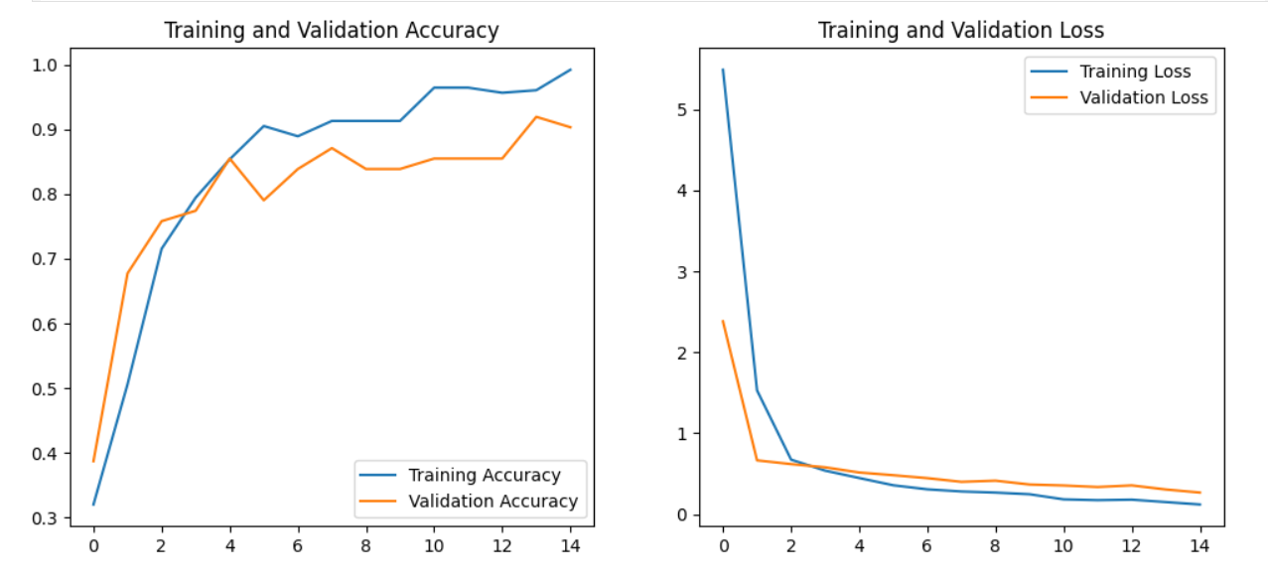
Results (Performance)
Overall Accuracy: The model achieved a peak accuracy of 98.2%.
Precision & Recall: High precision in identifying Adenocarcinoma, which is often the hardest to detect in early stages.
Clinical Significance: The fusion of data reduced the error margin compared to image-only models.

Slide 9
Outputs
The Confusion Matrix shows minimal misclassification between "Normal" and "Malignant" cases.
Training Time: 15 Epochs were sufficient to reach convergence.
Inference Speed: Analysis is completed in less than 1 second, making it viable for hospital use.

Slide 10
Conclusion
Our research proves that combining AI with clinical context significantly boosts early detection rates.
The VGG16-based hybrid model provides a robust "Second Opinion" for radiologists.
We successfully addressed the limitations of manual screening by achieving 98.2% accuracy.

Slide 11
Future Scope
Grad-CAM Implementation: Adding "Explainable AI" to show doctors exactly where the model sees the cancer.
Real-time Deployment: Developing a web-based portal where doctors can upload scans and get instant reports.
Larger Multimodal Fusion: Including genomic data for even more personalized prognosis.

Slide 12
References
[1] Mohamed Hany, "Chest CT-Scan images Dataset," Kaggle.
[2] Simonyan & Zisserman, "Very Deep Convolutional Networks for Large-Scale Image Recognition.“
[3] Lin, S., et al. (2023), "A Deep Learning-Based Model for Lung Cancer Survival Analysis," Cancers.
[4] Rajesh, P., et al., "Lung Cancer Diagnosis and Treatment Using AI and Mobile Applications."

